Slide 2
ASP.NET WebAPI I OWIN - TEORIJA U PRAKSI Srđan poznić

Slide 3
Agenda
OWIN/Katana
WebAPI
Demo
Configuration
Authentication
Security
IoC
REST Best practices
Notes:
- VS tips
Set-ExecutionPolicy AllSigned
Set-ExecutionPolicy Unrestricted

Slide 4
OWIN
The Open Web Interface for .NET
OWIN is a community-owned specification, not an implementation
Abstraction between .NET web servers and web applications
Creates middleware for .NET web development
Port web applications to other hosts
Notes:
- VS tips
Set-ExecutionPolicy AllSigned
Set-ExecutionPolicy Unrestricted

Slide 5
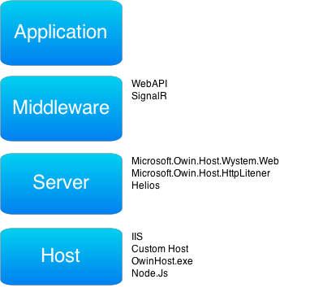
Owin/Katana Overview
Notes:
Abstraction based on 2 core elements:
IDictionary<string, object>
owin.RequestHeaders - IDictionary<string, string[]>
owin.RequestMethod – string ("GET", "POST")
….
Func<IDictionary<string, object>, Task>

Slide 6
Katana
Katana project represents the set of OWIN components (built and released by Microsoft)
Components:
SignalR
WebAPI

Slide 7
Katana - Goals
Portable
easily substituted
self hosted separately
Modular/flexible
Lightweight/performant/scalable

Slide 8
Owin/Katana Overview

Slide 9
Katana - Host
IIS/ASP.NET
Custom Host
OwinHost.exe
Notes:
IIS/ASP.NET
Standard HttpModule and HttpHandler
Both server and host
No substitution of the server
Custom host
Owin.exe host
Pre-built executable

Slide 10
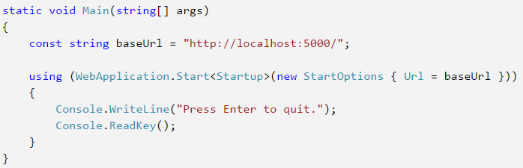
Katana – Custom Host

Slide 11
Katana - Server
Microsoft.Owin.Host.SystemWeb
IIS
For ASP.NET Web applications, it sends the requests into the ASP.NET pipeline
HttpModule and HttpHandler to intersect requests
Microsoft.Owin.Host.HttpListener
Default server selection
.NET Framework’s HttpListener

Slide 12
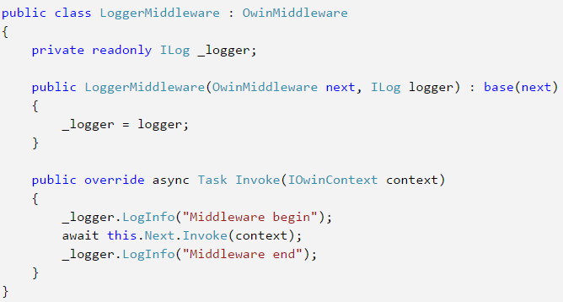
Katana - Middleware
Derive OwinMiddleware class

Slide 13
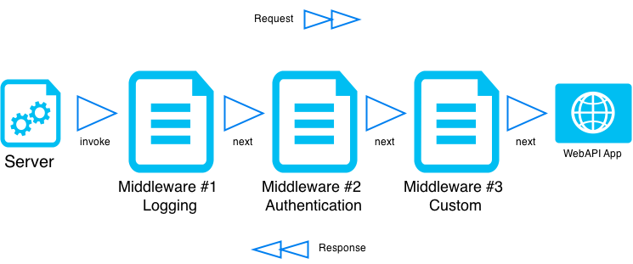
Katana - Middleware
Notes:
http://www.asp.net/aspnet/overview/owin-and-katana
http://www.asp.net/aspnet/overview/owin-and-katana/an-overview-of-project-katana
http://www.asp.net/aspnet/overview/owin-and-katana/owin-startup-class-detection

Slide 14
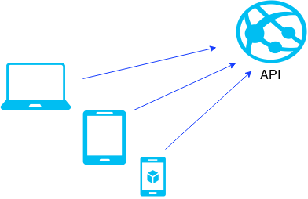
WebAPI
RESTful Framework used for building HTTP based services
Exposes a specific software functionality to programs to interact with each other and share data.

Slide 15
WebAPI
REST - Representational state transfer
URLs represent resources
Service is stateless
http://service.com/api/resources/{id}
http://service.com/api/resources/{id}/relation

Slide 16
WebAPI
Web Api != Asp.Net MVC
Web Api != WCF

Slide 17
WebAPI – When to use?
Want RESTful endpoints
Working ONLY with HTTP
No need to support multiple protocols
No need for SOAP endpoints
Need Simple Configuration
Multiple hosting options

Slide 18
WCF – When to use?
Want to support multiple protocols
Need to expose SOAP endpoints
Need Complex Configuration
Need RPC Style Requests

Slide 19
WebAPI Features
Hosting
IIS
Self host
Public access to the methods
CRUD (Post, Get, Put/Patch, Delete)
Handlers
Filters

Slide 20
WebAPI Features
Simple configuration (routing)
IoC support
Validation
Global Exception handling

Slide 21
WebAPI Features
Call interception
Custom serializers
Json/XML
Media type negotiation

Slide 22
WebAPI
Most so-called RESTful APIs are not RESTful at all!
Most “RESTful APIs” are really “Resource APIs”
not bad at all ☺

Slide 23
Demo
Structure
Configuration
IoC
Authentication
Security
Filters
Routing
OData Queries
Logging and Exception Handling

Slide 24
Tips and best practices
Endpoint name should be plural
/books
/cars
Use nouns but no verbs
/books
/books/27
GET method and query parameters should not alter the state (use PUT, POST and DELETE)

Slide 25
Tips and best practices
Use sub-resources for relations
GET /books/12/authors/
GET /books/12/authors/1
Use HTTP headers for serialization formats
Both client and server must know which format is used

Slide 26
Tips and best practices
Provide filtering, sorting, field selection and paging for collections
GET /cars?color=black
GET /cars?sort=-manufactorer,+model
GET /cars?fields=manufacturer,model,id,color
GET /cars?offset=10&limit=5
Version your API
/blog/api/v1
HTTP 301/302
Notes:
Versioning: SDammann.WebApi.Versioning package

Slide 27
Tips and best practices
Handle Errors with HTTP status codes
200 – OK – Everything is working
201 – OK – New resource created
204 – OK – The resource successfully deleted
304 – Not Modified – The client can use cached data
400 – Bad Request
401 – Unauthorized
403 – Forbidden
404 – Not found
500 – Internal Server Error

Slide 28
Tips and best practices
Good documentation
SSL everywhere - all the time
JSON only responses
It's time to leave XML behind in APIs
Authentication and Security
CORS
A RESTful API should be stateless
OAuth 2 with Bearer tokens

Slide 29
Questions?

Slide 30
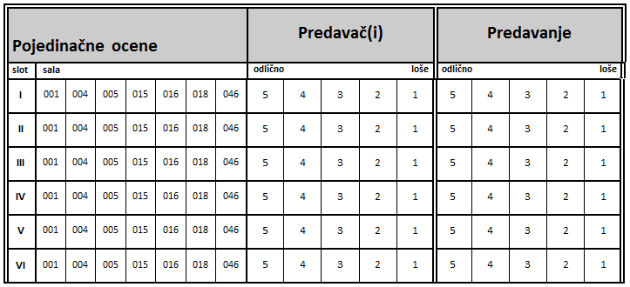
Agenda

Slide 32
Hvala! / Thank You!

